Slide 1
Chapter 7 Linear programming and reductions
School of Science, Yanshan University
Wang Gang

Slide 2
Linear programming
Objective function max x₁ + 6x₂ Standard form max c^{T}x
Constraints x₁ ≤ 200 Ax ≤ b
x₂ ≤ 300 x ≥ 0
x₁+ x₂ ≤ 400
x₁, x₂ ≥ 0
Variants of LP can be reduced to one another via simple transformations.
(1) max min: multiply the coefficients of the objective function by −1
(2) slack(surplus) variables: turn inequality constraints into equations
(3) change equality constraints into inequalities:
ax = b ax ≤ b, ax ≥b
(4) variables unrestricted in sign:
􀀀

Slide 3
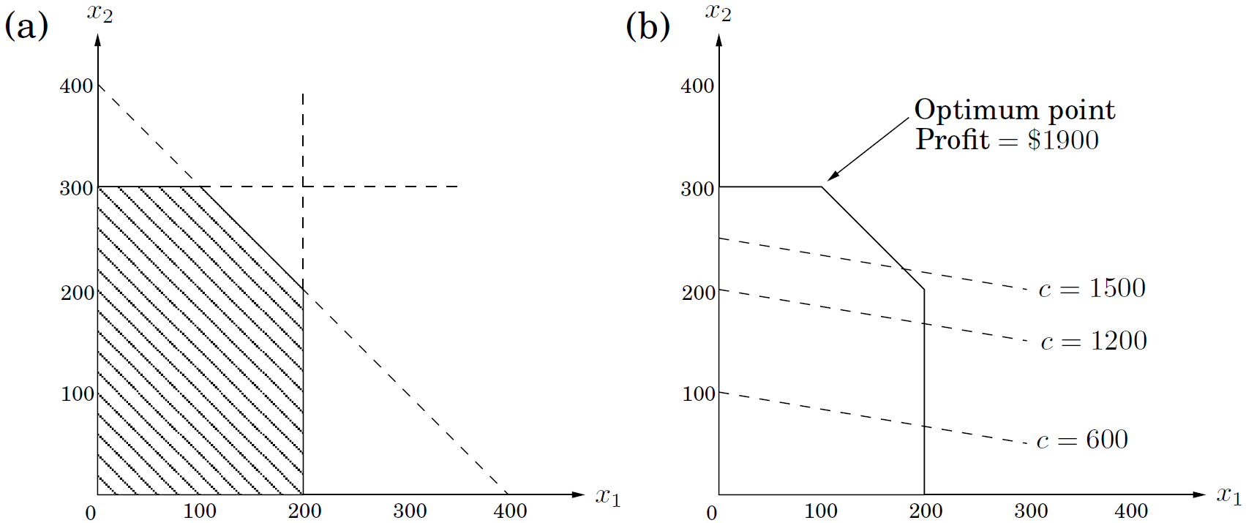
Linear programming
Feasible region:
too many constraints, empty feasible region
too few constraints, unbounded feasible region

Slide 4
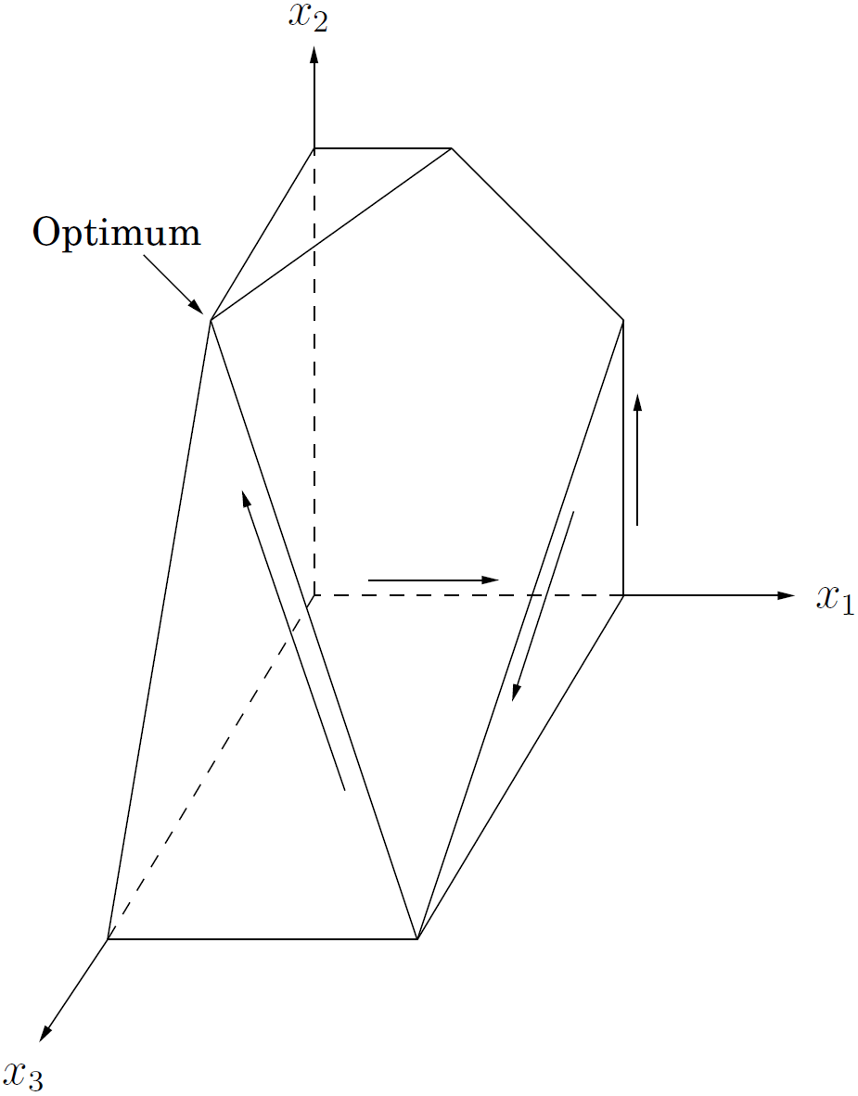
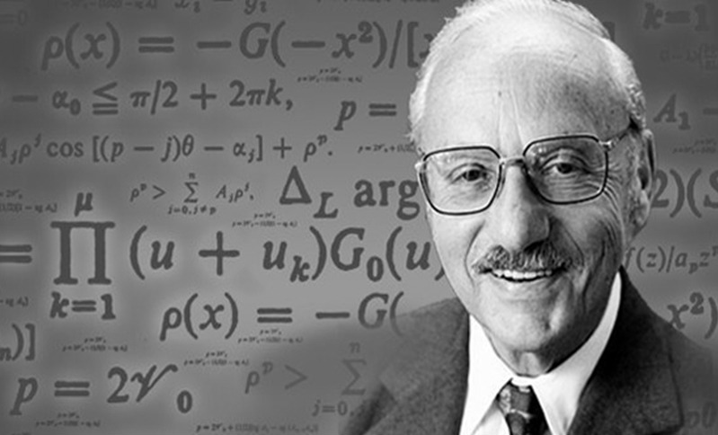
Linear programming
Feasible region:
too much constraints, empty feasible region
too little constraints, unbounded feasible region
The simplex algorithm (George Dantzig, 1947): does hill-climbing on the vertices of the feasible polygon.

Slide 5
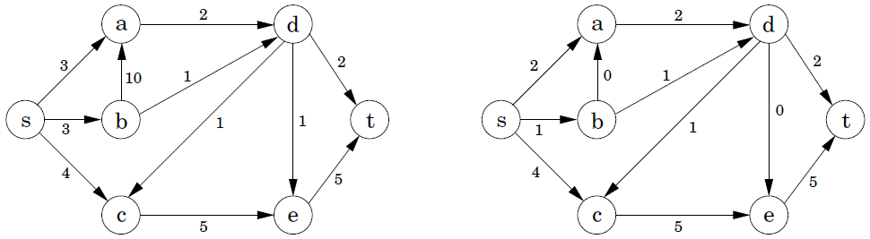
Flows in networks
Flow network: digraph G=(V, E), source s, sink t, edge capacities c_{e} > 0.
Flow: a function that satisfies the following
Capacity constraint: 0 ≤ f_{e} ≤ c_{e}
Flow conservation:
maximum flow:
The maximum flow problem reduces to linear programming.

Slide 6
Flows in networks
By simulating the behavior of simplex, we get Ford-Fulkerson method for solving max-flow directly.
Given a flow f, the residual network G^{f} =(V, E^{f}, s, t, c^{f}) has two types of edges, and ,
if f_{uv}< c_{uv}, , else ; (flow-increasing opportunities)
if f_{uv}> 0, . (flow-decreasing opportunities)
An augmenting path is a path from s to t in the residual network G^{f}.
Ford-Fulkerson Method (V, E, s, t, c_{e})
1. initialize flow f to 0
2. while there exists an augmenting path p in the residual network G^{f}
3. augment flow f along p
4. return f

Slide 7
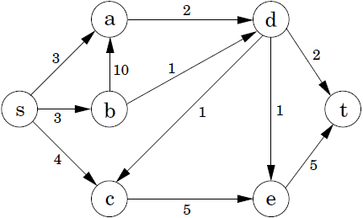
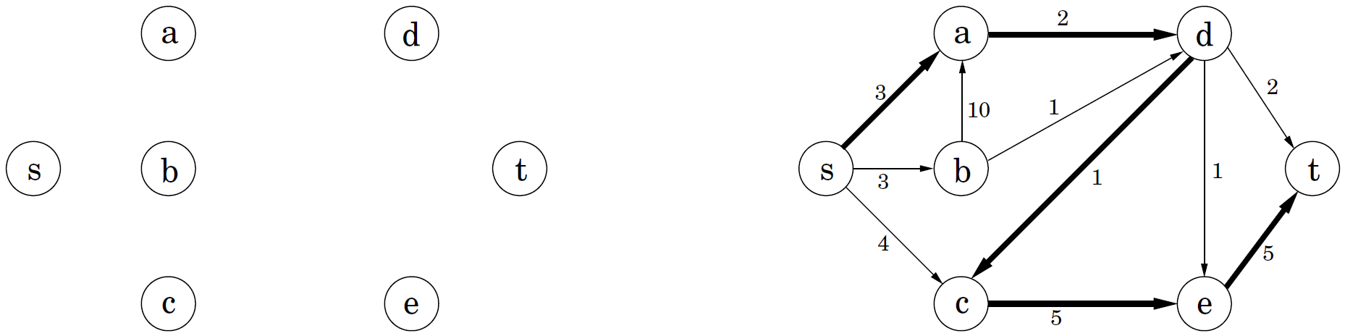
Flows in networks
By simulating the behavior of simplex, we get Ford-Fulkerson method for solving max-flow directly.
Current flow Residual network
Ford-Fulkerson Method (V, E, s, t, c_{e})
1. initialize flow f to 0
2. while there exists an augmenting path p in the residual network G^{f}
3. augment flow f along p
4. return f

Slide 8
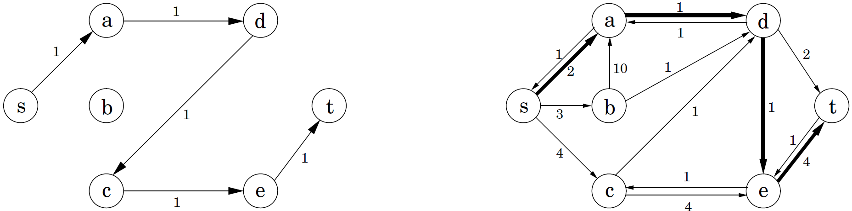
Flows in networks
By simulating the behavior of simplex, we get Ford-Fulkerson method for solving max-flow directly.
Current flow Residual network
Ford-Fulkerson Method (V, E, s, t, c_{e})
1. initialize flow f to 0
2. while there exists an augmenting path p in the residual network G^{f}
3. augment flow f along p
4. return f

Slide 9
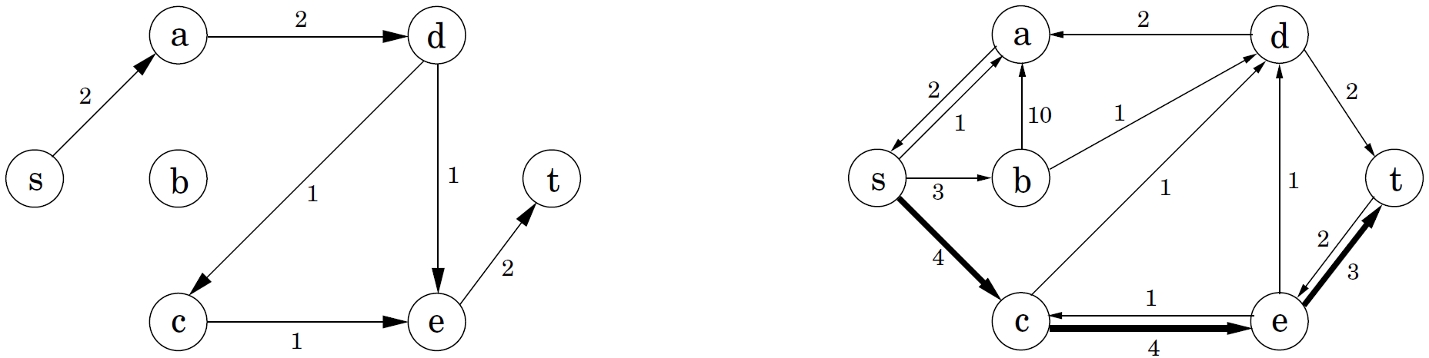
Flows in networks
By simulating the behavior of simplex, we get Ford-Fulkerson method for solving max-flow directly.
Current flow Residual network
Ford-Fulkerson Method (V, E, s, t, c_{e})
1. initialize flow f to 0
2. while there exists an augmenting path p in the residual network G^{f}
3. augment flow f along p
4. return f

Slide 10
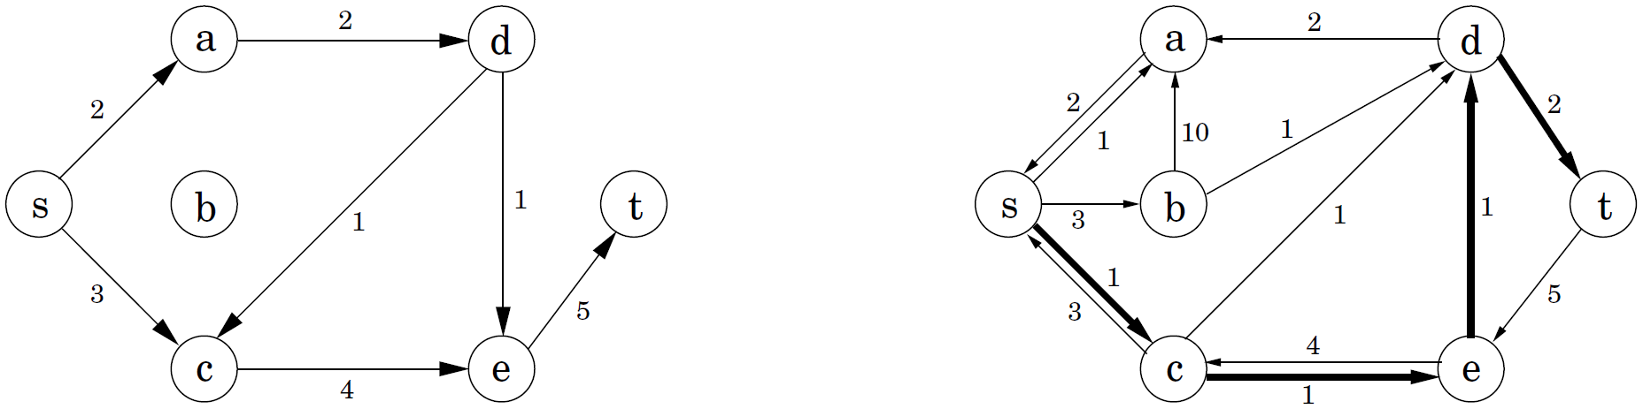
Flows in networks
By simulating the behavior of simplex, we get Ford-Fulkerson method for solving max-flow directly.
Current flow Residual network
Ford-Fulkerson Method (V, E, s, t, c_{e})
1. initialize flow f to 0
2. while there exists an augmenting path p in the residual network G^{f}
3. augment flow f along p
4. return f

Slide 11
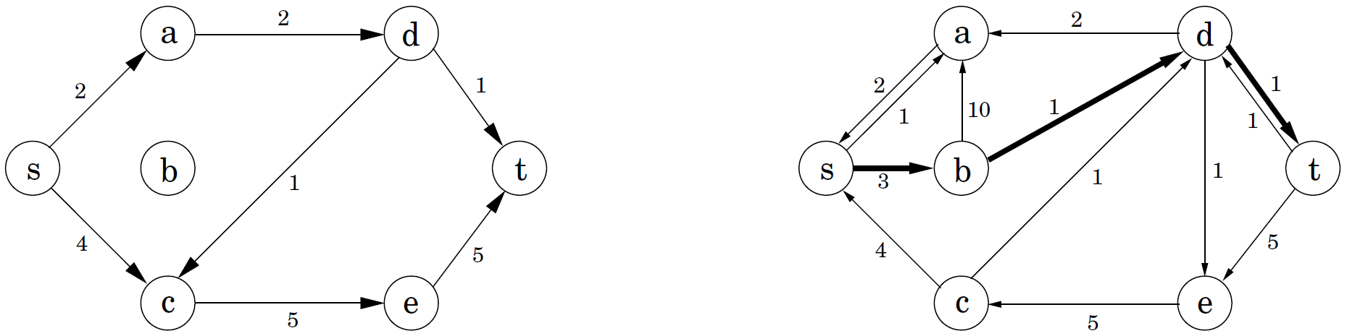
Flows in networks
By simulating the behavior of simplex, we get Ford-Fulkerson method for solving max-flow directly.
Current flow Residual network
Ford-Fulkerson Method (V, E, s, t, c_{e})
1. initialize flow f to 0
2. while there exists an augmenting path p in the residual network G^{f}
3. augment flow f along p
4. return f

Slide 12
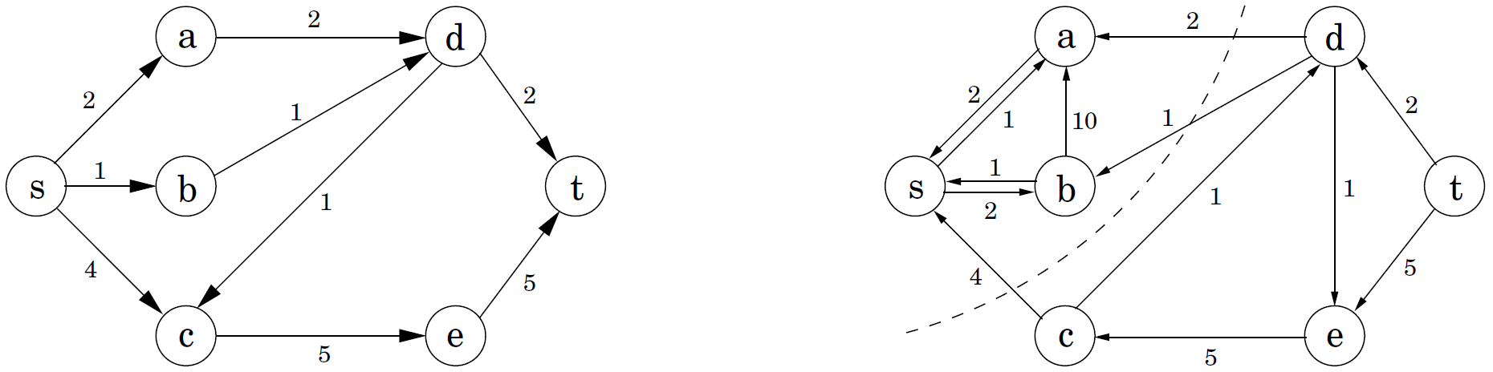
Flows in networks
By simulating the behavior of simplex, we get Ford-Fulkerson method for solving max-flow directly.
Current flow Residual network
Ford-Fulkerson Method (V, E, s, t, c_{e})
1. initialize flow f to 0
2. while there exists an augmenting path p in the residual network G^{f}
3. augment flow f along p
4. return f

Slide 13
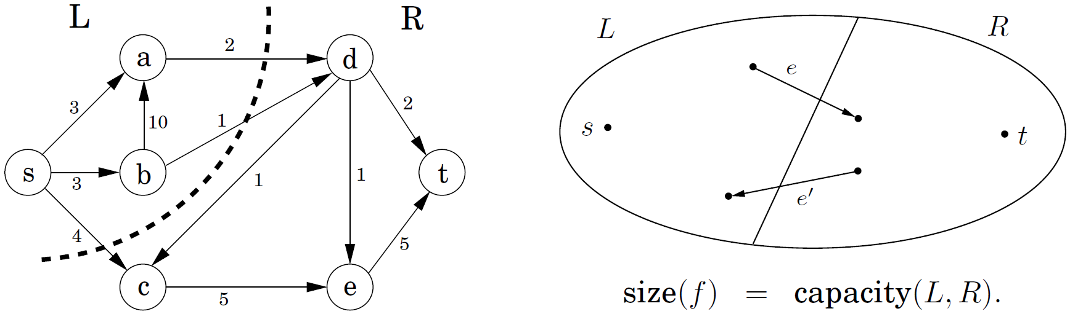
Flows in networks
(s, t)-cut: V is partitioned into two sets L and R,
capacity(L, R): the total capacity of the edges from L to R;
any flow f, any (s, t)-cut, .
Let f be the final flow. Now t is no longer reachable from s in G^{f}. Let L be the nodes reachable from s in G^{f}, R = V−L. Then (L, R) is a cut in the graph G, and size(f) = capacity(L, R). ?
Max-flow min-cut theorem: The size of a maximum flow in a network equals the capacity of a smallest (s, t)-cut.

Slide 14
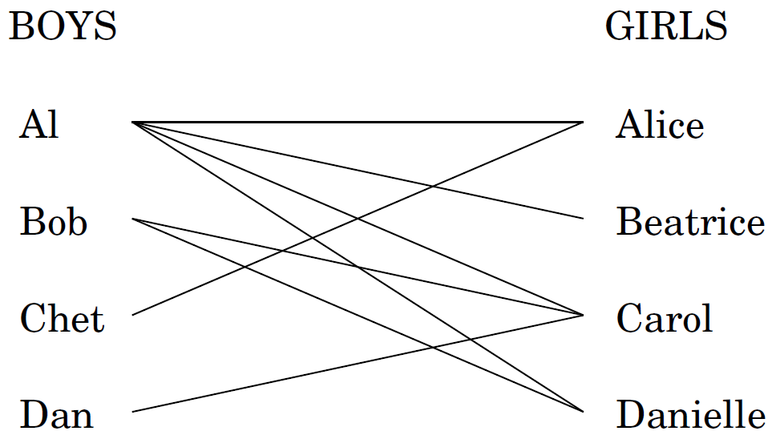
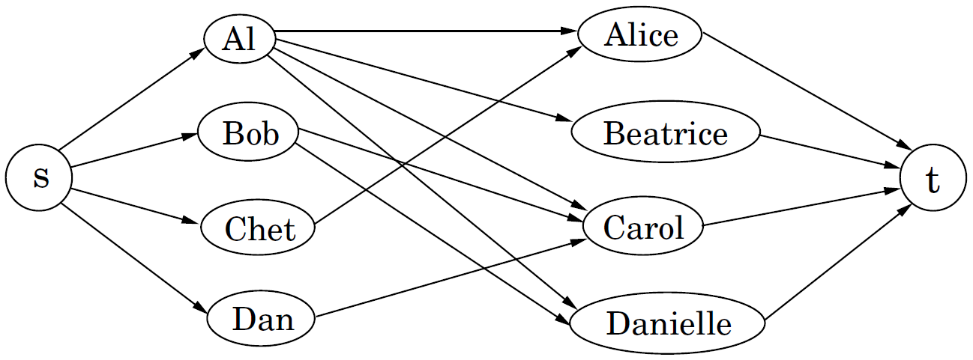
Bipartite matching
Problem:
Solution:
Integrity of Ford-Fulkerson method: If all edge capacities are integers, then the optimal flow found by Ford-Fulkerson method is integral. Because the capacity of any augmenting path is an integer.

Slide 15
Duality in Linear Programming
max x₁+6x₂ Optimum solution: (x₁, x₂) = (100, 300)
x₁ ≤ 200 Objective value: 1900
x₂ ≤ 300
x₁ + x₂ ≤ 400
x₁ ≥ 0
x₂ ≥ 0
①*0+②*5+③*1 ≤ 1900 (y₁, y₂, y₃) = (0, 5, 1)
Multiplier Inequality
y₁ x₁ ≤ 200
y₂ x₂ ≤ 300
y₃ x₁ + x₂ ≤ 400
(y₁+y₃)x₁+(y₂+y₃)x₂ ≤ 200y₁+300y₂+400y₃

Slide 16
Duality in Linear Programming
max x₁+6x₂ Optimum solution: (x₁, x₂) = (100, 300)
x₁ ≤ 200 Objective value: 1900
x₂ ≤ 300
x₁ + x₂ ≤ 400
x₁ ≥ 0
x₂ ≥ 0
①*0+②*5+③*1 ≤ 1900 (y₁, y₂, y₃) = (0, 5, 1)
Multiplier Inequality
y₁ x₁ ≤ 200
y₂ x₂ ≤ 300
y₃ x₁ + x₂ ≤ 400
(y₁+y₃)x₁+(y₂+y₃)x₂ ≤ 200y₁+300y₂+400y₃
If 1x₁+6x₂ ≤ (y₁+y₃)x₁+(y₂+y₃)x₂,
then 200y₁+300y₂+400y₃ will be an upper bound on the optimum solution.

Slide 17
Duality in Linear Programming
If 1x₁+6x₂ ≤ (y₁+y₃)x₁+(y₂+y₃)x₂,
then 200y₁+300y₂+400y₃ will be an upper bound on the optimum solution.
(y₁, y₂, y₃) is easy to find. But it may tell us a far too loose upper bound.
Dual LP: The tightest upper bound!
min 200y₁+300y₂+400y₃ Optimum solution: (y₁, y₂, y₃) = (0, 5, 1)
y₁ +y₃ ≥ 1 Objective value: 1900
y₂ +y₃ ≥ 6
y₁ ≥ 0
y₂ ≥ 0
y₃ ≥ 0

Slide 18
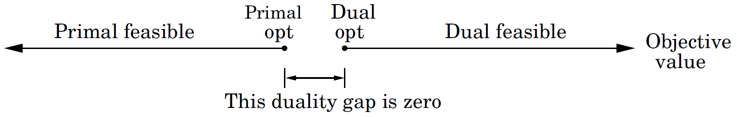
Duality in Linear Programming
Duality theorem: If a linear program has a bounded optimum, then so does its dual, and the two optimum values coincide.
Primal LP Dual LP
max c^{T}x min y^{T}b
Ax ≤ b y^{T}A ≥ c^{T}
x ≥ 0 y ≥ 0
By design, dual feasible values ≥ primal feasible values. The duality theorem tells us that moreover their optima coincide.

Slide 19
Zero-sum games
matrix games rock-scissors-paper:
payoff matrix G =
If Row always makes the same move, Column will quickly catch on and will always play the countermove, winning every time.
mixed strategy: a probability distribution that assigns to each available action a likelihood of being selected.
Both Row and Column play mixed strategies. Then the expected payoff is
Row wants to maximize this payoff. Column wants to minimize it.

Slide 20
Zero-sum games
If Row plays the strategy (1/3,1/3,1/3), then no matter
what pure strategy Column plays, the expected payoff
is 0.
Since the payoff of any mixed strategy (y₁, y₂, y₃) is
just a weighted average of the individual payoffs for
playing pure strategy r, p, and s, it must also be 0.
Row can force an expected payoff ≥ 0, no matter what Column does.
Column can force an expected payoff ≤ 0, no matter what Row does.
(1/3,1/3,1/3) is best for both players. Its expected payoff is 0.

Slide 21
Zero-sum games
Nonsymmetric game ― presidential election:
Suppose Row will play the mixed strategy x = (1/2,1/2). Column's best response must be the pure strategy y = (0,1).
Once Row's strategy x = (x₁, x₂) is fixed, Column must either move m, with payoff 3x₁−2x₂, or move t, with payoff −x₁+x₂, whichever is smaller. Because any mixed strategy y is a convex combination of these two pure strategies and thus cannot beat the better of the two.

Slide 22
Zero-sum games
If Row is forced to announce x before Column plays,
she knows his best response will achieve an expected
payoff of min{3x₁−2x₂, −x₁+x₂}. She should choose x
defensively to maximize her payoff against this best
response.
A little trick:
z = min{3x₁−2x₂, −x₁+x₂}
max z
z ≤ 3x₁−2x₂
z ≤ −x₁+ x₂
Row needs to choose x₁, x₂ to
max z
−3x₁+2x₂+z ≤ 0
x₁− x₂+z ≤ 0
x₁+ x₂ = 1
x₁ ≥ 0
x₂ ≥ 0

Slide 23
Zero-sum games
Symmetrically, if Column has to announce his strategy
first, his best bet is to choose the mixed strategy y that
minimizes his loss under Row's best response,
In LP form, this is
min w
−3y₁+ y₂+w ≤ 0
2y₁− y₂+w ≤ 0
y₁+ y₂ = 1
y₁ ≥ 0
y₂ ≥ 0

Slide 24
Zero-sum games
The two best strategies are dual LPs to each other.
max z min w
−3x₁+2x₂+z ≤ 0 −3y₁+ y₂+ w ≤ 0
x₁− x₂+z ≤ 0 2y₁− y₂+w ≤ 0
x₁+ x₂ = 1 y₁ + y₂ = 1
x₁ ≥ 0 y₁ ≥ 0
x₂ ≥ 0 y₂ ≥ 0
Min-max theorem (John von Neumann, 1928).
For any two-person zero-sum game,

Slide 25
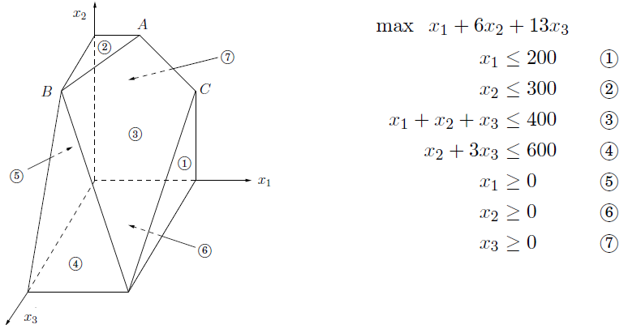
The simplex algorithm
Suppose there are n variables, and m+n constraints in LP,
A linear equality constraint defines a hyperplane;
A linear inequality constraint defines a half-space;
The feasible region of the linear program is a convex polyhedron;
Each vertex is specified by a set of n inequalities; (degenerate*)
Two vertices are neighbors if they share n−1 defining inequalities.

Slide 26
The simplex algorithm
max c^{T}x
Ax ≤ b
x ≥ 0
Simplex (George Dantzig, 1947):
On each iteration, simplex has two tasks:
(1). Check whether the current vertex is optimal (and if so, halt).
(2). Determine where to move next.
When the current vertex v = 0:
Suppose 0 is feasible. n inequalities x ≥ 0 are tight. 0 must be a vertex. Task (1): 0 is optimal iff all c_{i} ≤ 0.
Task (2): If some c_{i} > 0, 0 is not optimal. Increase the objective function by raising x_{i} (release x_{i} ≥ 0), until some other inequality, previously loose, now becomes tight. Now, we again have exactly n tight inequalities, so we are at a new vertex.
let v be any vertex of the feasible region
while there is a neighbor v₀ of v with better objective value
set v = v₀

Slide 27
The simplex algorithm
Simplex can be started at 0 = (0, 0), which is specified by constraints (4) and (5). To move, we release the tight constraint x₂ ≥ 0. As x₂ is gradually increased, the first constraint it runs into is -x₁+ x₂ ≤ 3 , and thus it has to stop at x₂ = 3, at which point this new inequality is tight. The new vertex (0, 3) is thus given by (4) and (3).
max 2x₁+ 5x₂
2x₁− x₂ ≤ 4 (1)
x₁+ 2x₂ ≤ 9 (2)
-x₁+ x₂ ≤ 3 (3)
x₁ ≥ 0 (4)
x₂ ≥ 0 (5)

Slide 28
The simplex algorithm
When the current vertex v is not 0, rewrite LP:
Initial LP: max 2x₁+5x₂ 2x₁− x₂ ≤ 4 (1) x₁+2x₂ ≤ 9 (2) −x₁+ x₂ ≤ 3 (3) x₁ ≥ 0 (4) x₂ ≥ 0 (5) | Current vertex: {(4), (5)}(origin). Objective value: 0. Move: increase x₂. (5) is released, (3) becomes tight. Stop at x₂ = 3. New vertex {(4), (3)} has local coordinates (y₁, y₂): y₁ = x₁; y₂ = 3+x₁−x₂
Rewritten LP: max 15+7y₁–5y₂ y₁+ y₂ ≤ 7 (1) 3y₁−2y₂ ≤ 3 (2) y₂ ≥ 0 (3) y₁ ≥ 0 (4) −y₁+ y₂ ≤ 3 (5) | Current vertex: {(4), (3)}. Objective value: 15. Move: increase y₁. (4) is released, (2) becomes tight. Stop at y₁ = 1. New vertex {(2), (3)} has local coordinates (z₁, z₂): z₁ = 3−3y₁+2y₂; z₂ = y₂

Slide 29
The simplex algorithm
When the current vertex v is not 0, rewrite LP:
Rewritten LP: max 15+7y₁–5y₂ y₁+ y₂ ≤ 7 (1) 3y₁−2y₂ ≤ 3 (2) y₂ ≥ 0 (3) y₁ ≥ 0 (4) −y₁+ y₂ ≤ 3 (5) | Current vertex: {(4), (3)}. Objective value: 15. Move: increase y₁. (4) is released, (2) becomes tight. Stop at y₁ = 1. New vertex {(2), (3)} has local coordinates (z₁, z₂): z₁ = 3−3y₁+2y₂; z₂ = y₂
Rewritten LP: max 22− z₁− z₂ − z₁+ z₂ ≤ 6 (1) z₁ ≥ 0 (2) z₂ ≥ 0 (3) z₁− z₂ ≤ 1 (4) z₁+ z₂ ≤ 4 (5) | Current vertex: {(2), (3)}. Objective value: 22. Optimal: all c_{i} < 0. Solve (2),(3) (in original LP) to get optimal solution: (x₁, x₂) = (1, 4).
$$\frac{7}{3}$$
$$\frac{1}{3}$$
$$\frac{1}{3}$$
$$\frac{1}{3}$$
$$\frac{1}{3}$$
$$\frac{2}{3}$$
$$\frac{1}{3}$$
$$\frac{1}{3}$$

Slide 30
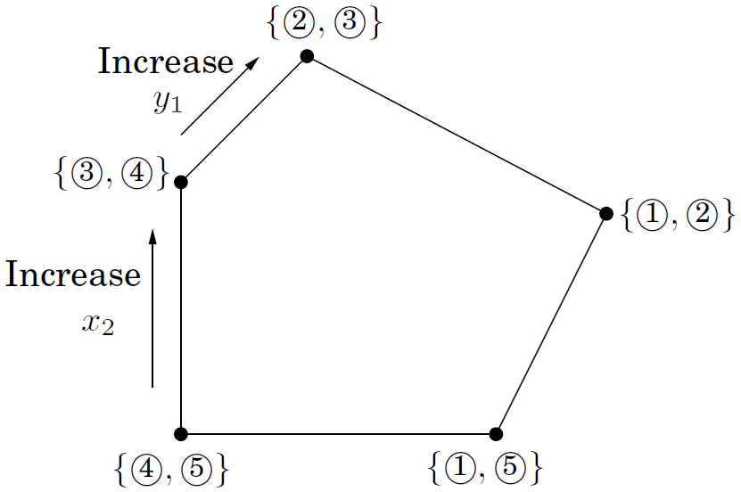
The simplex algorithm
When the current vertex v is not 0, rewrite LP:
Rewritten LP: max 22− z₁− z₂ − z₁+ z₂ ≤ 6 (1) z₁ ≥ 0 (2) z₂ ≥ 0 (3) z₁− z₂ ≤ 1 (4) z₁+ z₂ ≤ 4 (5) | Current vertex: {(2), (3)}. Objective value: 22. Optimal: all c_{i} < 0. Solve (2), (3) in original LP to get optimal solution: (x₁, x₂) = (1, 4).
$$\frac{7}{3}$$
$$\frac{1}{3}$$
$$\frac{1}{3}$$
$$\frac{1}{3}$$
$$\frac{1}{3}$$
$$\frac{2}{3}$$
$$\frac{1}{3}$$
$$\frac{1}{3}$$

Slide 31
The simplex algorithm
Finding a starting vertex can be reduced to an LP and solved by simplex!
Rewrite LP this way:
, if b_{i} < 0, multiply both sides of the ith equation by −1.
Create a new LP:
Start simplex with (x=0, z=b) to obtain a optimum solution (x', z').
As for the optimum value of z₁+z₂+···+z_{m}, there are two cases:
(1). z₁+z₂+···+z_{m}=0. Then z' = 0. x' is a starting vertex of the original LP.
(2). z₁+z₂+···+z_{m}>0. The original LP is infeasible.
min c^{T}x
Ax = b
x ≥ 0
min z₁+z₂+···+z_{m}
Ax + z = b
x ≥ 0
z ≥ 0

Slide 32
The simplex algorithm
Complexity:
Rewrite LP ;
vertices;
Simplex is an exponential-time algorithm.
LP P
Ellipsoid algorithm, Leonid Khachiyan, 1979.
Interior point method, Narendra Karmarkar, 1984.
Smoothed Complexity, Spielman & Teng, 2001.
Measures the expected performance of algorithms under slight random perturbations of worst-case inputs. If the smoothed complexity of an algorithm is low, then it is unlikely that the algorithm will take a long time to solve practical instances whose data are subject to slight noises and imprecisions.

Slide 33
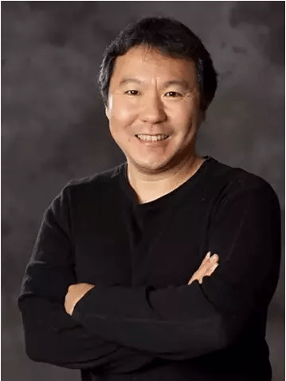
滕尚华
滕尚华(1964－)：南加州大学计算机科学教授。
1985年，上海交通大学，电气工程和计算机
科学双学士。
1988年，南加州大学，计算机科学硕士。
1991年，卡内基梅隆大学，计算机科学博士。
2008年，算法的平滑复杂性，获理论计算机
领域最高奖—ACM哥德尔奖(Gödel Prize)。
2009年，美国数学学会和美国数学规划学会
颁发的福尔克森奖(Fulkerson Prize)。
2015年，近线性时间拉普拉斯求解器，再次
荣膺哥德尔奖。
ACM Fellow，SIAM Fellow。
Notes:
父母就职于太原理工大学

Slide 34
Gaussian elimination
Gaussian elimination: an algorithm for solving systems of linear equations.
Complexity: O(n³)
Procedure gauss(E, X)
Input: A system E={e₁,…, e_{n}} of equations in n variables X={x₁,…, x_{n}}
e₁: a₁₁x₁+a₁₂x₂+···+a_{1n}x_{n}=b₁; ···; e_{n}: a_{n1}x₁+a_{n2}x₂+···+a_{nn}x_{n}=b_{n}
Output: A solution of the system, if one exists
if all coefficients a_{i1}= 0
halt with message ''either infeasible or not linearly independent''
if n=1 return b₁/a₁₁
choose the coefficient a_{p1} of largest magnitude, and swap equations e₁, e_{p}
for i = 2 to n
e_{i} = e_{i}−(a_{i1}/a₁₁)·e₁
(x₂,…, x_{n}) = gauss(E−{e₁}, X−{x₁})
x₁ = (b₁−Σ_{j>1}a_{1j}x_{j})/a₁₁
return (x₁,…, x_{n})

Slide 35
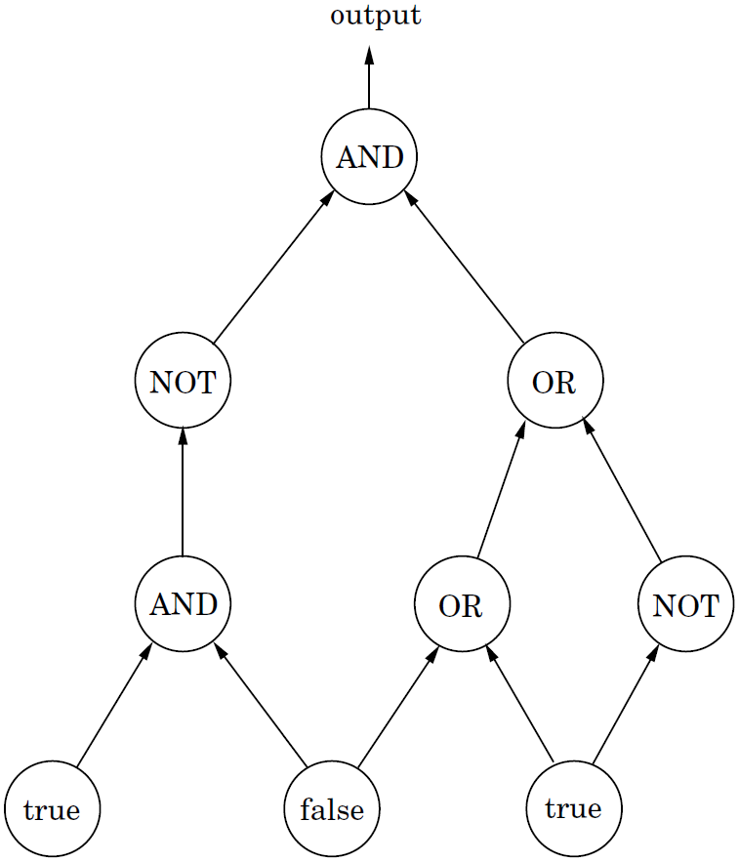
circuit evaluation
A Boolean circuit is a dag of Input gates, AND gates, OR gates, and NOT gates. In addition, one of the gates is designated as the output.
Circuit Value: When the laws of Boolean logic are applied to the gates in topological order, does the output evaluate to true?

Slide 36
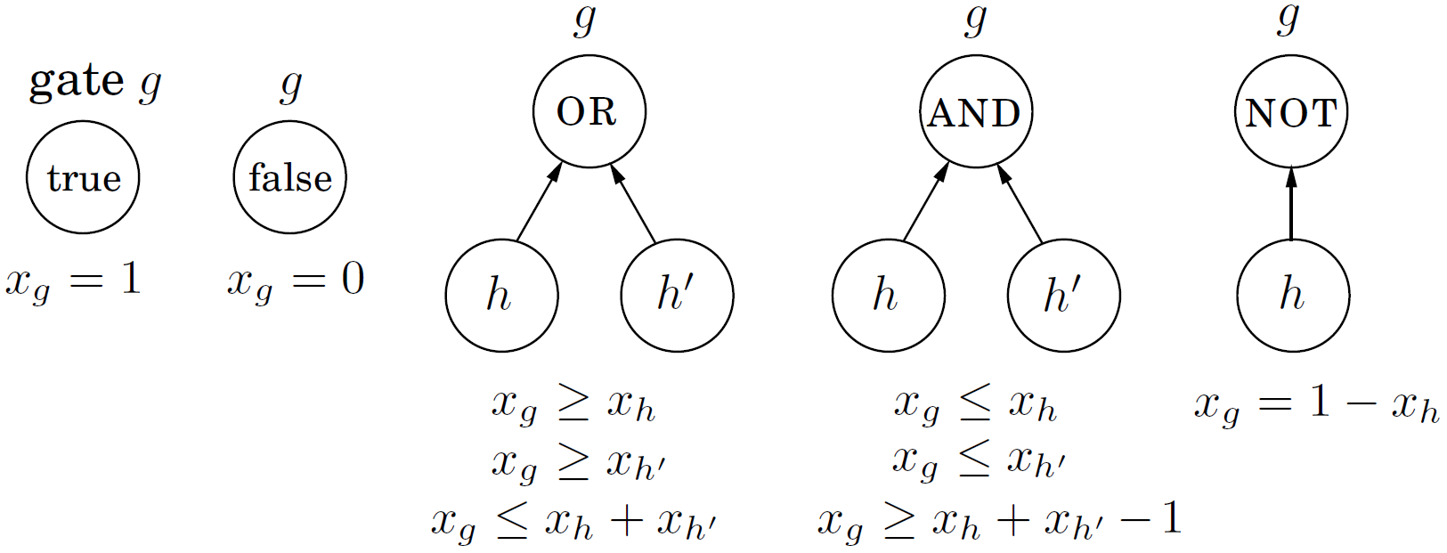
circuit evaluation
Circuit Value can be reduced to LP:
Create a variable x_{g} for each gate g, with constraints 0 ≤ x_{g} ≤ 1. Add additional constraints for each type of gate:
Circuit Value is in a sense the most general problem in P!
An algorithm runs in polynomial time on a CPU === A Boolean circuit consisting of polynomially many copies of the CPU's circuit, one per unit of time, with the values of the gates in one layer used to compute the values for the next.
Notes:
最一般的多项式时间可解问题！
poly时间算法在CPU上运行===poly个CPU电路拷贝逐时刻衔接。
电路求值问题可归约为线性规划，从而任意多项式时间可解问题亦可。
布尔电路是一个DAG，从而也可以动态规划求解！

Slide 37
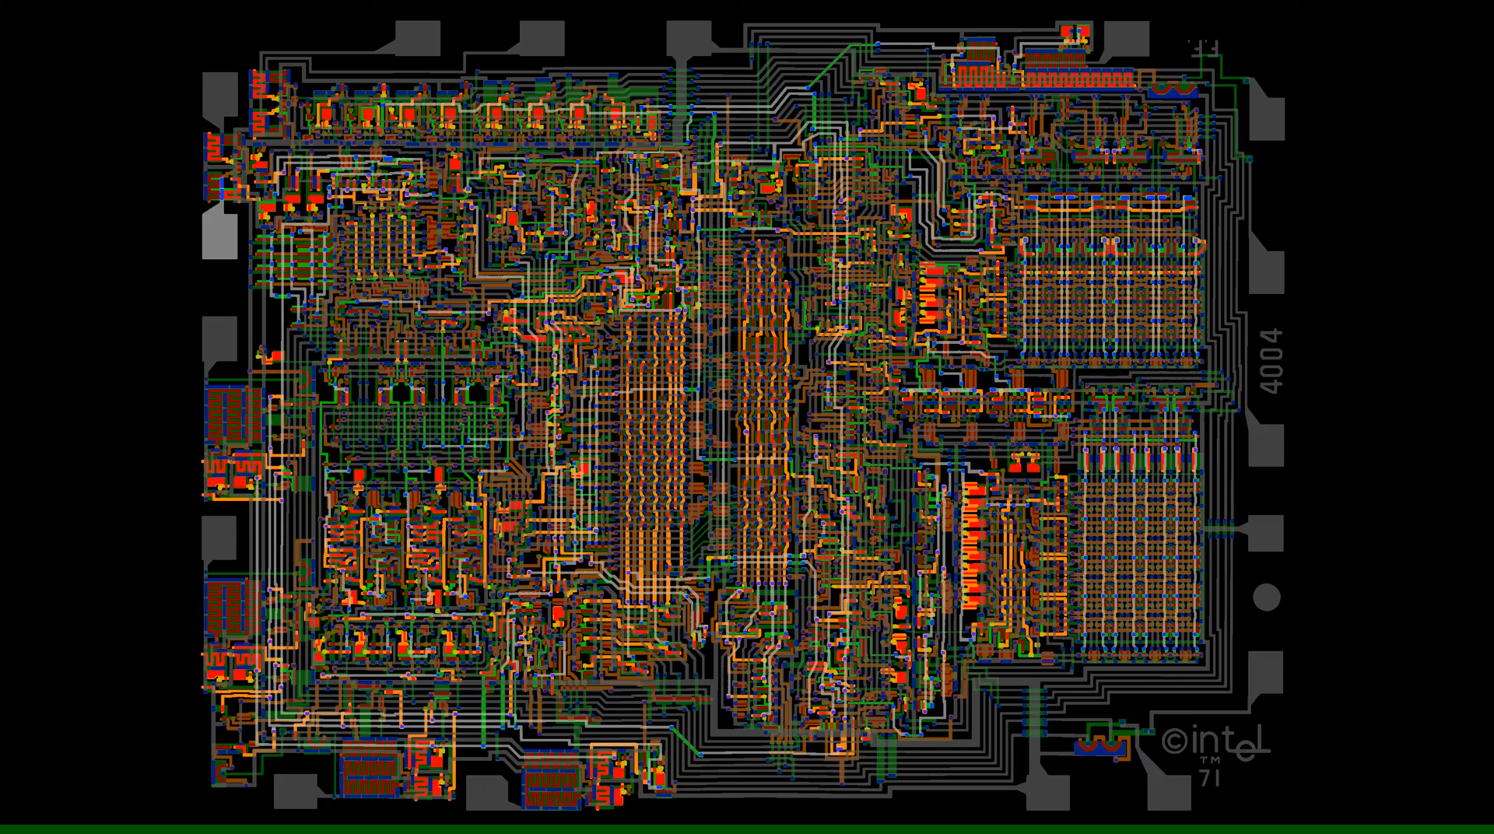
circuit evaluation
Intel 4004 Visual Transistor-level Simulation
Notes:
最一般的多项式时间可解问题！
poly时间算法在CPU上运行===poly个CPU电路拷贝逐时刻衔接。
电路求值问题可归约为线性规划，从而任意多项式时间可解问题亦可。
布尔电路是一个DAG，从而也可以动态规划求解！

